Slide 1


OUTLINE DEFENSE
Presenters:
George Andrei D. Gatan
Nathaniel C. Lagnaoda

Slide 2

CHAPTER 1

Slide 3

Introduction
Educational institutions today face increasing demand for printing and document-handling services from students, faculty, and staff.
Traditional manual print stations often lead to delays, long queues, and inefficient workflow, especially during peak periods.

Slide 4
Introduction
This study aims to design, develop, implement and evaluate a Self Service Printing Kiosk in the SKSU-Isulan Library that integrates a cashless payment system via GCash.

Slide 5
General Objectives
This study generally aims to develop a self-service printing kiosk station in SKSU-Isulan library that provides students and users with a convenient, automated, and cashless payment service through GCash.

Slide 6
Specific Objectives
1. Design a web-based system for document handling and printing.
2. allow the platform for seamless and cashless transactions through GCash.
3. Utilize the touch screen interface payment platform for seamless and cashless transactions through GCash.
3. Generate data analytics for sales, transaction logs, usage and printing volume .

Slide 7
Specific Objectives
4. Evaluate the system in terms of:
4.1. Functionality
4.2 Reliability
4.3 User Convenience

Slide 8
Significance of the Study
To the Students.
To the Library Staff and Administrators
To the University Management
To the Researchers
To the Future Researchers

Slide 9
Scope and Limitation

Slide 10
Scope
This study focuses on the design, development, and evaluation of a Self Service Printing Kiosk at the Sultan Kudarat State University – Isulan Campus (SKSU–Isulan) Library, integrated with a cashless payment system via GCash.

Slide 11
Scope
The system aims to provide students, faculty, and staff with a convenient, automated, and secure method of printing documents without the need for manual assistance.

Slide 12
Scope
The evaluation of the system centers on three major criteria:
Functionality
Reliability, and
User convenience.

Slide 13
Limitation
The study is limited only to the library setting of SKSU–Isulan Campus.
The cashless payment feature is restricted to GCash transactions through the Xendit API.
The respondents consist of random students, faculty, and library staff of SKSU–Isulan Campus who participated in testing and providing feedback.

Slide 14
Operational Definition of Terms
Administrator
Cashless Payment
Database
Functionality
GCash
Xedit API
Raspberry Pi 4
Reliability
Self-Service
Printing Kiosk
SKSU-Isulan Library System Interface
User Convenience
Data Analytics

Slide 15
REVIEW OF RELATED LITERATURE
CHAPTER II

Slide 16
RELATED LITERATURE
Raspberry Pi
Inkjet Printer
Touch Screen Display
Quick Response (QR) Code
Common Unix Printing System (CUPS)
Xendit
Gcash
Self Service Technology
Kiosk
Cashless Payment

Slide 17
RELATED STUDIES
Self Service Technology(SST) in Education Institute
Cashless Payment and User Acceptance in The Philippines
Operational and Institutional Benefits of Cashless Systems
Kiosk-Based Automation and System Architecture
AI and Iot-Enhancement Self Service Kiosk
Cyber Security in Cashless Payments
Data Privacy and Protection in Fintech and E-Wallet Services

Slide 18
RELATED STUDIES
User Experience (UX), Convenience, and Accessibility in Digital Transaction
Demographic Influence on E-Wallet Adoption and User Experience
Self-Service and Automation Initiatives in Mindanao

Slide 19
Conceptual Framework

Slide 20
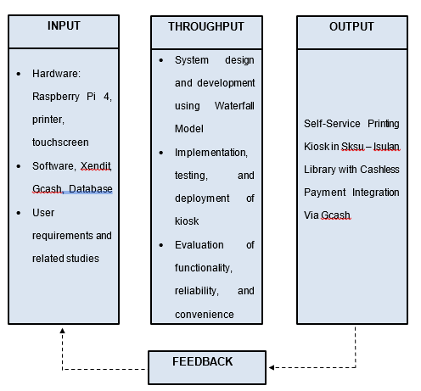
Figure 1. Conceptual Framework of the Study.

Slide 21
METHODOLOGY
CHAPTER III

Slide 22
Project Development Description
Tools and Equipments
Bill of Supplies and Materials
Project duration

Slide 23
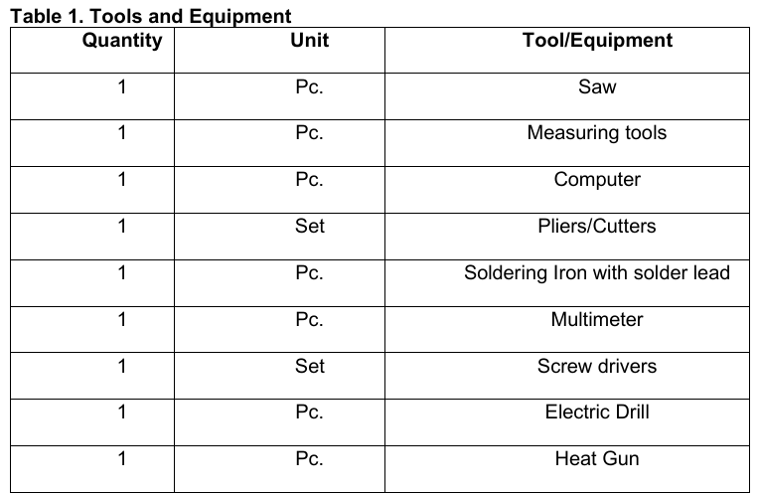

Slide 24
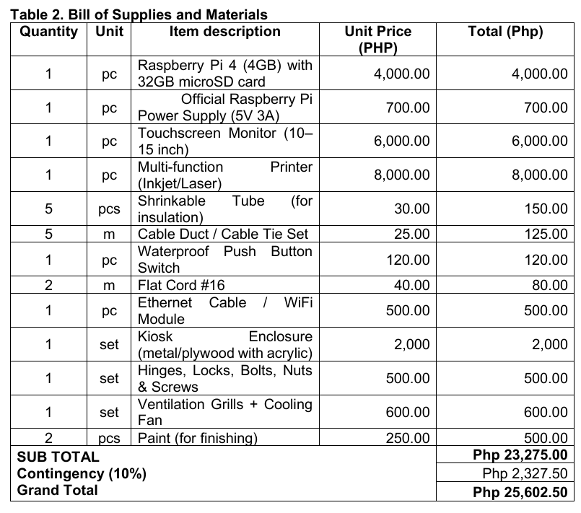

Slide 25
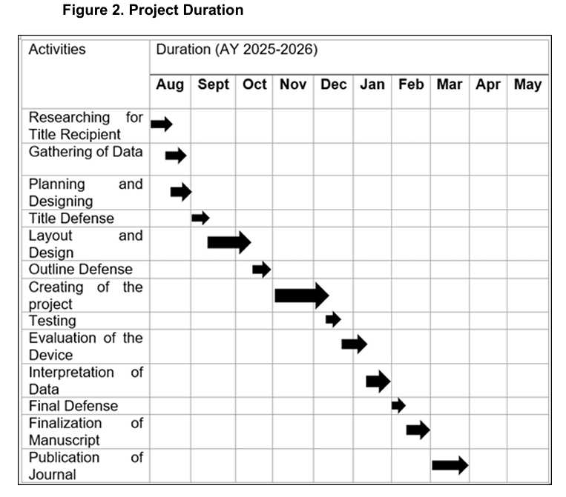

Slide 26
Software Development and Methodology
Context Diagram
Data Flow Diagram
Entity Relationship Diagram
Database Structure

Slide 27
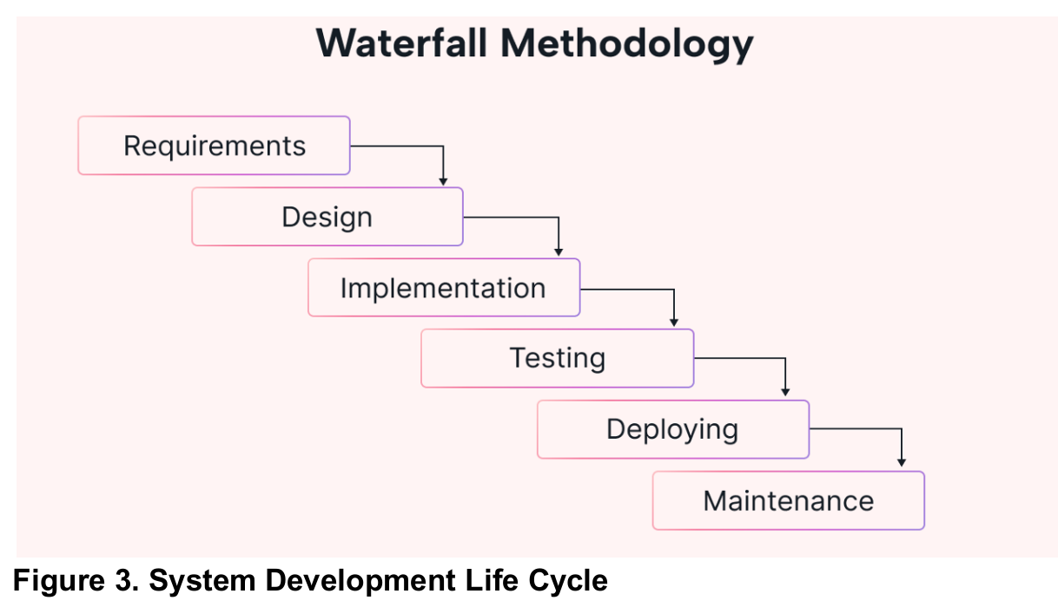

Slide 28
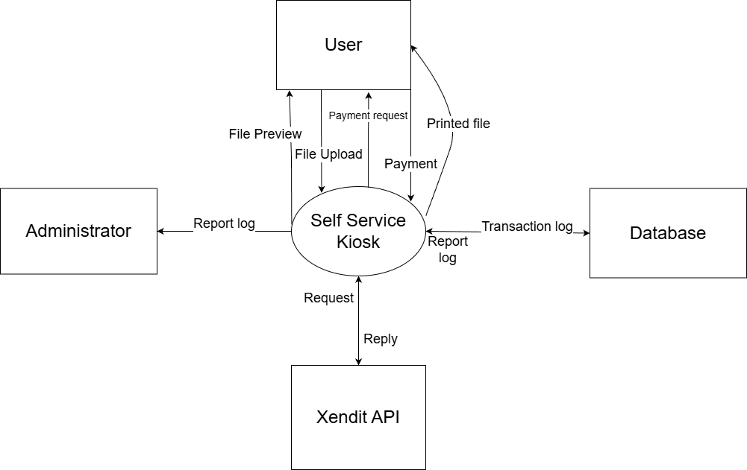
Figure 4. Context Diagram

Slide 29
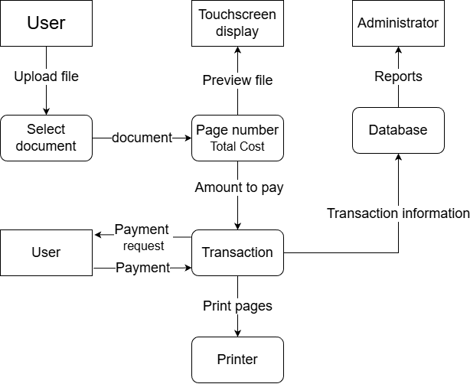
Figure 5. Data Diagram

Slide 30
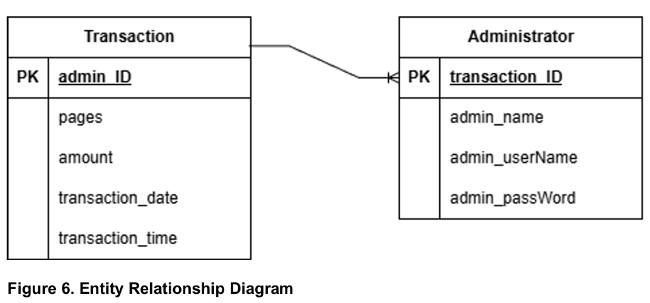

Slide 31
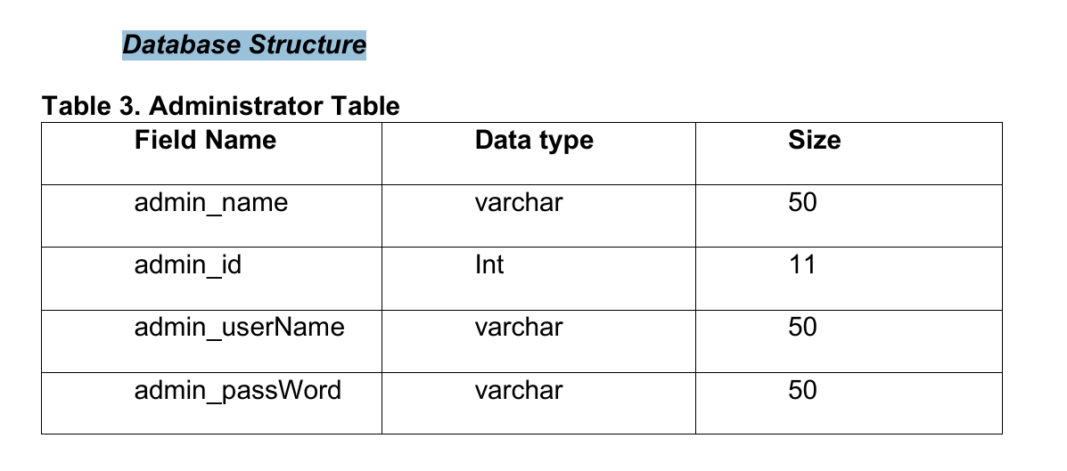

Slide 32
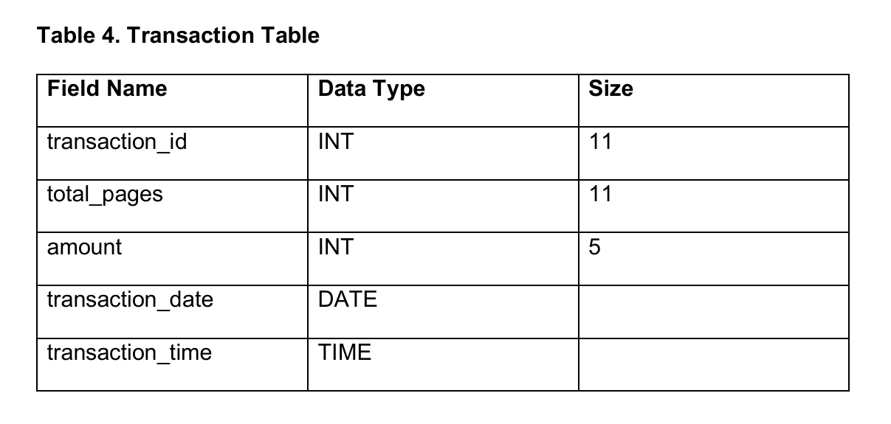

Slide 33
Hardware Development and Methodology
Perspective Plan
Construction Procedures
Flow Chart

Slide 34
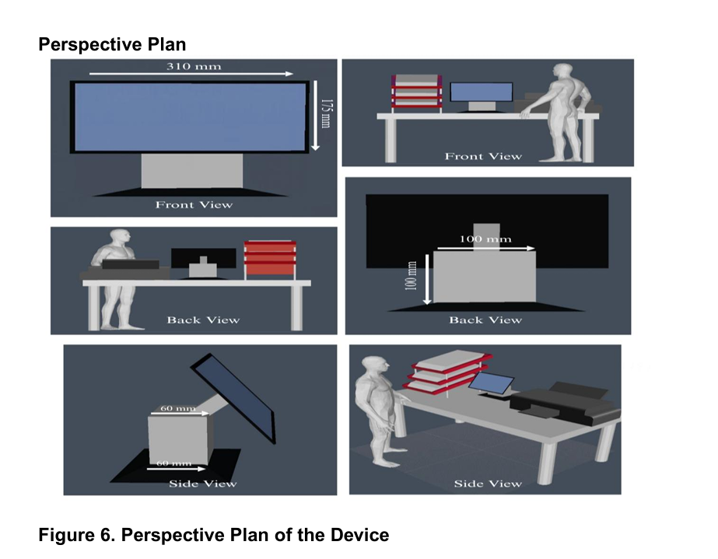

Slide 35
Construction Procedures
1. Gather all materials, supplies, and equipment required for constructing the kiosk, including the Raspberry Pi, touchscreen monitor, Inkjet printer, power supply, wiring, cooling fan, enclosure materials, hinges, and locks.
2. Fabricate the kiosk enclosure, which serves as the housing for all internal components such as the Raspberry Pi, power supply, and cable management system. Ventilation grills and cooling fans were also considered in the design to prevent overheating.

Slide 36
Construction Procedures
3. Install the main components, including the Inkjet printer in the side section of the kiosk for document output, the touchscreen monitors at eye level for the user interface, the Raspberry Pi on its mounting bracket.
4. Program the Raspberry Pi with the appropriate code to manage the file upload, page counting, Xendit API, payment request handling, printer control, and database logging.
5. Connect the electrical and electronic components, including the Raspberry Pi GPIO pins, printer interface, and cooling system, ensuring proper circuit assembly and insulation with shrink tubes and cable ducts.

Slide 37
Construction Procedures
6. Conduct initial testing of all components to verify if the Raspberry Pi boots properly, the printer responds to print requests, the touchscreen displays the interface, the Xendit API detects payments, and the payment confirmation from GCash allows the print job to proceed.
7. Perform troubleshooting and final adjustments based on the test results. Retest the system to ensure complete functionality, safety, and reliability of the kiosk before deployment in the SKSU – Isulan Library.

Slide 38
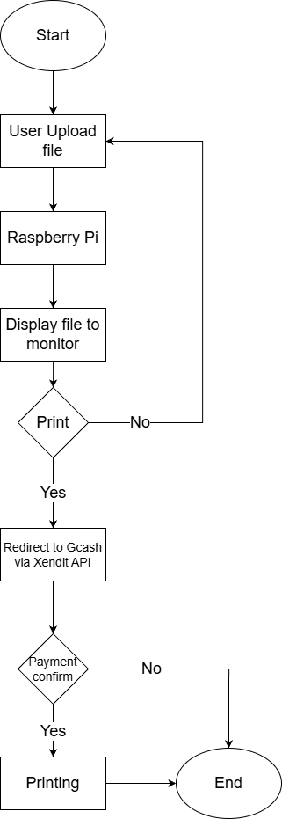
Figure 7. Flow Chart

Slide 39
Evaluation Methodology
Research Design
Locale of the Study
Methods of Research
Respondent of the Study
Sampling Procedure
Data Gathering Procedures
Data Gathering Instruments
Statistical Tools and Treatment of Data

Slide 40
Research Design
The type of method that was used for this study was descriptive research.
The researchers are required to gather information from the respondents by providing a questionnaire for evaluation of the study.
The questions from the questionnaire evaluate the functionality, reliability and user convenience of the self-service printing kiosk.

Slide 41
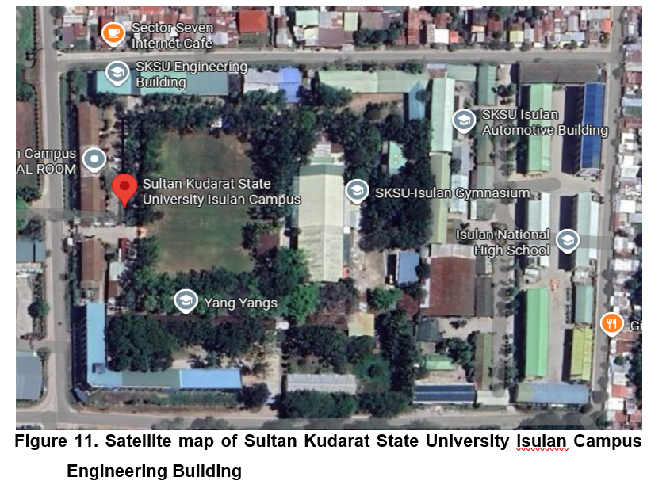
Locale of the Study

Slide 42
Methods of Research
A descriptive survey will be used.
The creation of a study questionnaire is the first action taken by researchers.
After the questionnaire has been created and distributed to respondents, the self-service printing kiosk are evaluated.
In the descriptive survey that was conducted, which will serve as the foundation for determining how reliable, effective and efficient the said system is, the respondents' perspectives, experiences, and views regarding the mobile application built are addressed.

Slide 43
Respondents of the Study
Students, faculty members, and staff of Sultan Kudarat State University – Isulan Campus, who are regular users of the university library and its facilities.
total of two hundred (200) respondents

Slide 44
Data Gathering Procedures
1. Prepare the web application and administrator website for evaluation.
2. Making research questionnaire.
3. Finalization of the questionnaire.
4. Distribution of questionnaire.
5. Testing and actual evaluation of the application.

Slide 45
Data Gathering Instruments
This study used a survey questionnaire as the data-gathering instrument.
The instrument was chosen since it is cost-effective and easy to manage.
The questionnaire comprises related questions wherein the respondents will rate the self-service printing kiosk based on their experience.
The researcher used a hard copy of the evaluation form to gather the data.

Slide 46
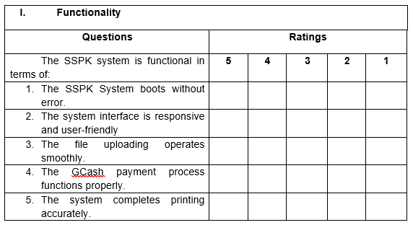

Slide 47
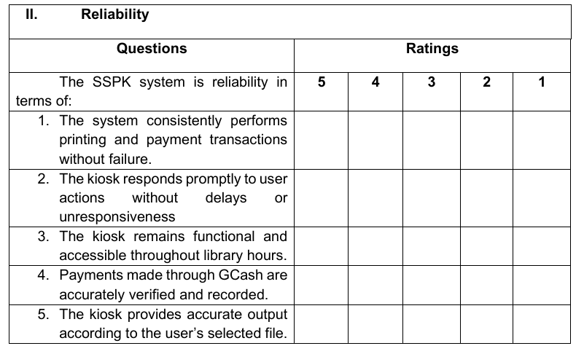

Slide 48
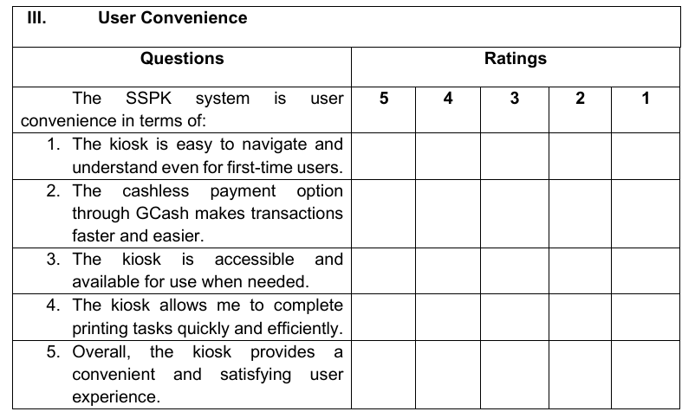

Slide 49
Statistical Tools and Treatment of Data
Data analysis and interpretation were done using descriptive statistics such as the 5-point Likert Rating Scale.
The 5-point Likert Rating Scale was statistically treated to determine the application's functionality, reliability, and user convenience.
The 5-point Likert Scale will be computed using the formula.

Slide 50

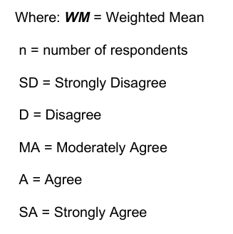

Slide 51
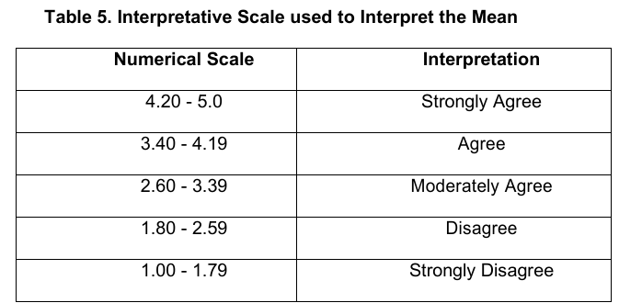

Slide 52
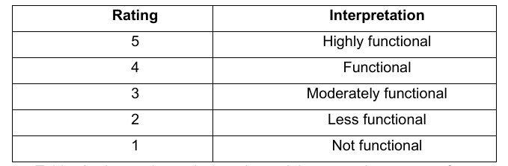
Table 6. Rating Scale used in Evaluating the Functionality of the System.

Slide 53
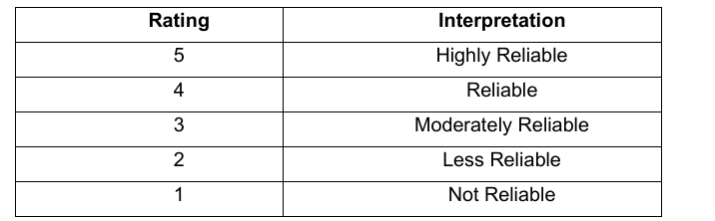
Table 7. Rating Scale used in Evaluating the Reliable of the System.

Slide 54
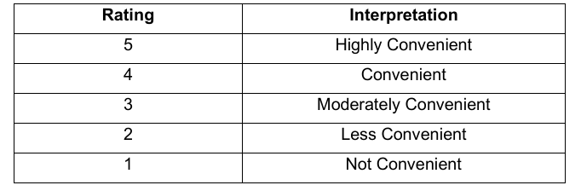
Table 8. Rating Scale used in Evaluating the User Convenience of the System.

Slide 55
THANK YOU

Slide 56
Questions or Reccomendation

Slide 57
OUTLINE DEFENDED!

